Slide 1
Apple Stock
Forecasting
Group 3
Mr. Pavan K
Miss. Shruti Madhukar Wadikar
Mr. Sagar M
Mr. Pavan Kumar
Miss. Gulshan K
Mr. Shubham Sanjay Kand

Slide 2
Data Description:
Data consists of 7 Features and 2011 Observations Date : Date of trading Open : Price at which security first trades High : Highest Price of the trading day Low : Lowest Price of the trading day Close : Last Price the stock traded during the trading day Adj Close : Price that is adjusts Corporate Actions on Closing Price Volume : Number of Shares that changed hands during the trading day

Slide 3
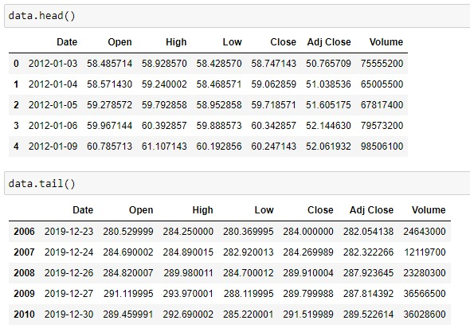
Data consists of observations from Jan 2012 to December 2019. As we can see, there are 2011 trading days even though the number of days in this period of time is much larger than 2011. This is because the stock market is not open on weekend and some USA's special days such as Independence day, Christmas Day, New Year's Eve and so forth. There are no missing and null values.

Slide 4
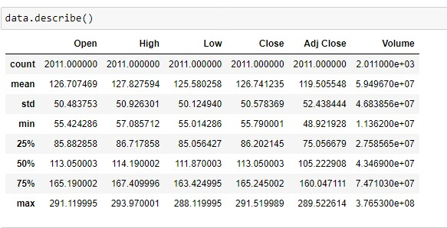
Data Statistics:

Slide 5
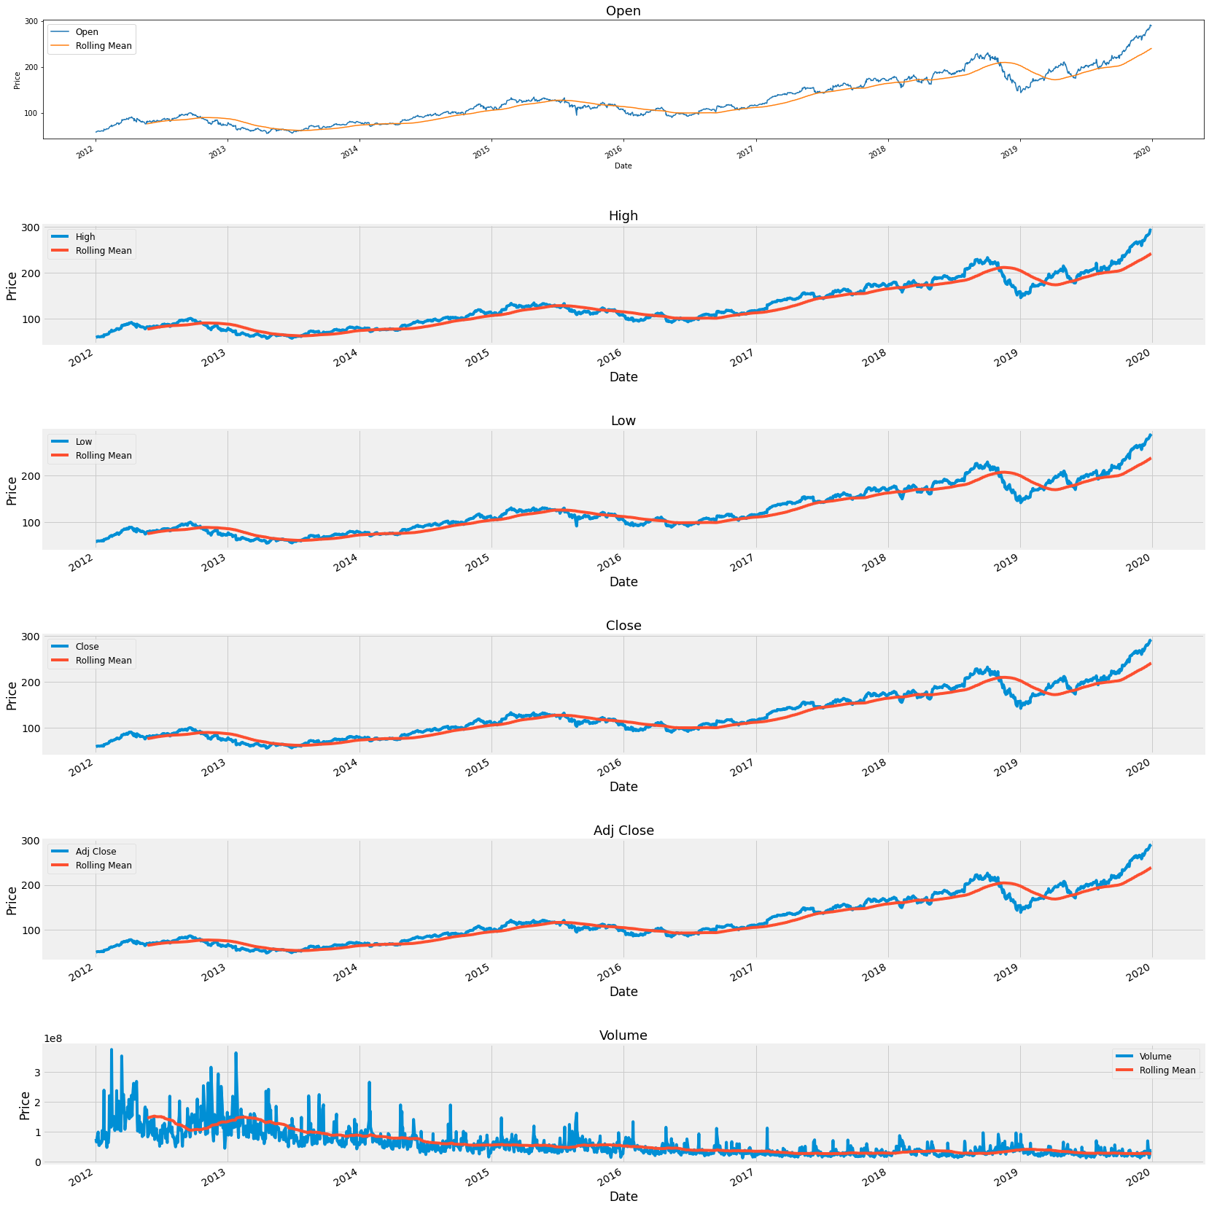
Rolling Mean of each feature:

Slide 6
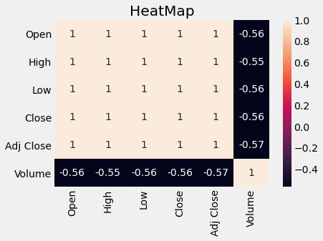
Correlation We consider Close as our target variables as it accounts for all corporate decisions like stock split and dividents.

Slide 7
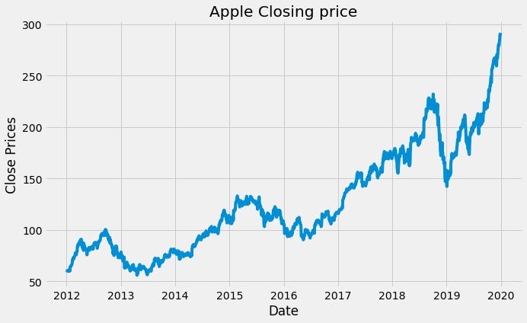
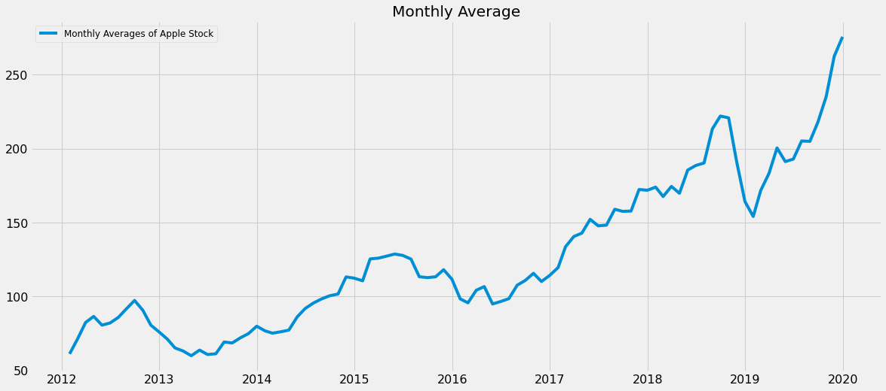
Yearly and Monthly Closing Price:

Slide 8
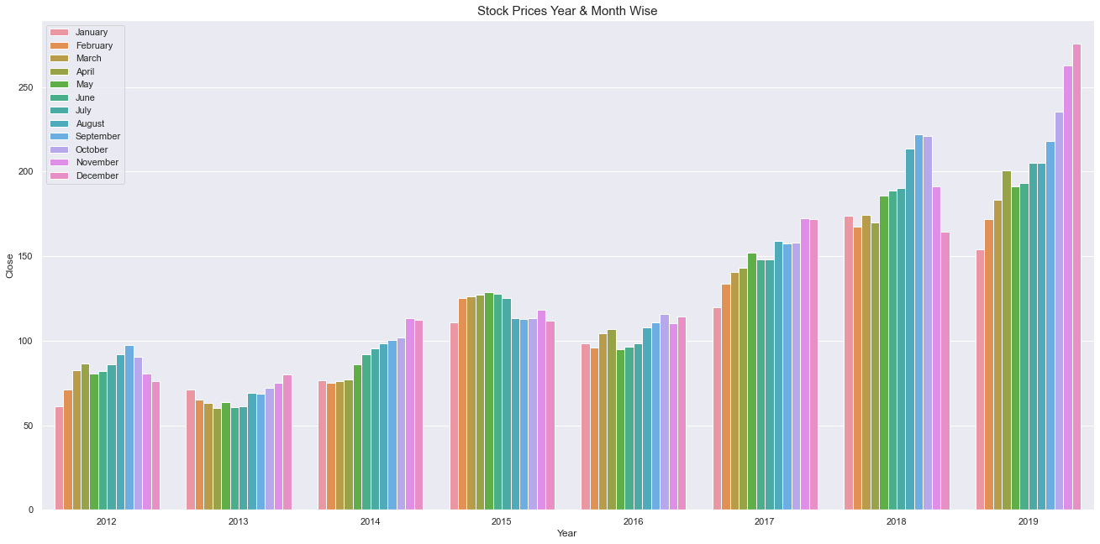
Year & Monthly Wise Stock Prices:

Slide 9
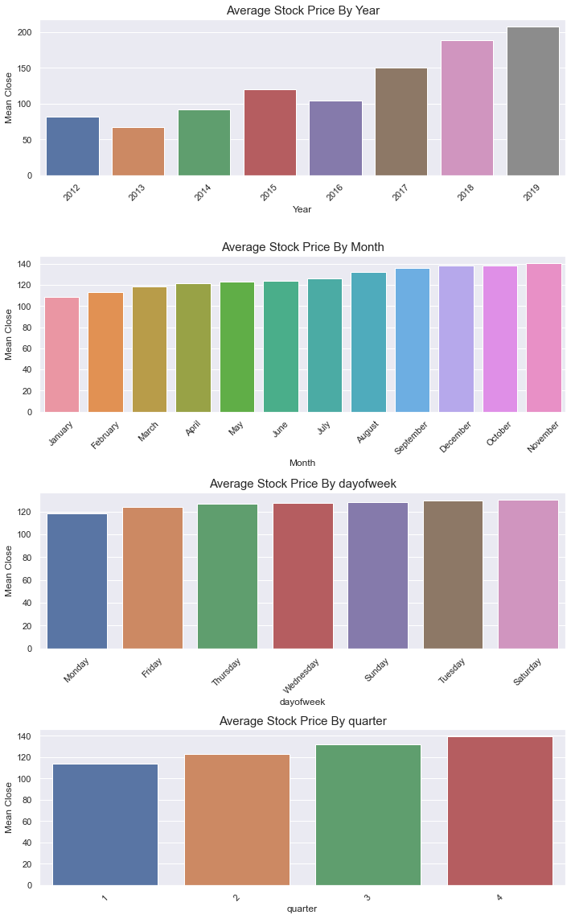
There is a constant increase in stock price from 2017. Average Stock Price is lower at start of the week in comparison to the end of the week. The Average Price increases in the last months of the year. Q4 is the best for Apple according to average stock price. By sales figures Q4 has always been strong for Apple since the new product cycle takes place and it's the Holiday period. We also observe this as a seasonal effect for Apple.

Slide 10
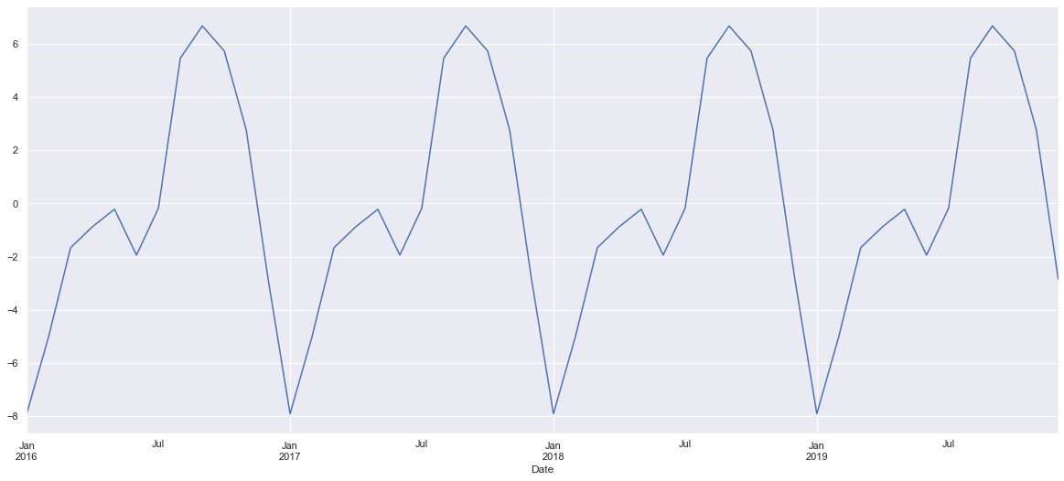
Presence of Seasonality in the data:

Slide 11
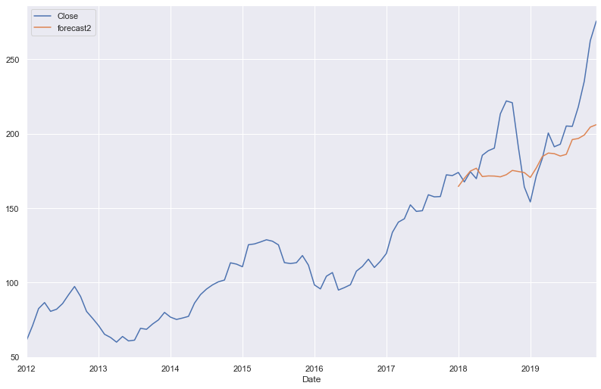
SARIMA model:
With RMSE value of 22.25 and MAPE value of 0.085

Slide 12
Model Deployment using Streamlit:

Slide 13
Thank You

